Slide 1
Abstractive Text Summarization
By Abhinav yalamaddi
Reg.no: 17MIS7077
Under the guidance of Dr. D. Sumathi

Slide 2
Objectives met
As mentioned in the previous review the basic idea behind this project is too able to extract a short subset of the most important information from a large set and present it in a human-readable format, which I was completely able to achieve.

Slide 3
Implementation
Preprocessing and Dataset
We trained our model on the Amazon Fine Food Reviews dataset from Kaggle was used for this project, which contains 500,000 reviews from 1999 to 2012., which is commonly used for training models for abstractive summarization. During preprocessing, we pulled out 80% dataset and summary which gave, and we trained our model to predict the abstractive summary given the review given by the user.
Ref: https://www.kaggle.com/snap/amazon-fine-food-reviews/download
Model
A Three Layer Stacked LSTM Encoder-Decoder model with Global Attention Mechanism was used during implementation. On the training set, I was able to achieve an accuracy of 77.27 percent using this model (constituting 80 percent of the dataset). This model also achieved a cumulative BLEU-4 score of 0.8800 on the test set.
Notes:
Global attention, on the other hand, makes use of the output from the encoder and decoder for the current time step only. This makes it attractive to implement in vectorized libraries such as Keras.

Slide 4
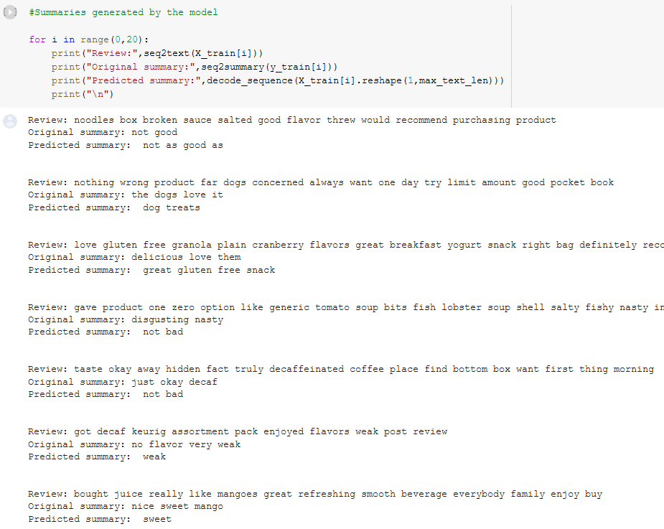
Test Cases

Slide 5
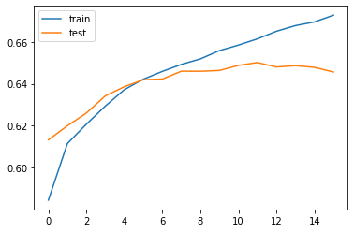
Accuracy graph

Slide 6
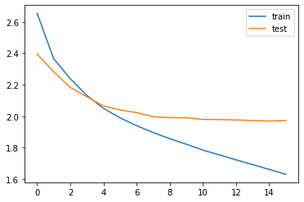
Loss graph

Slide 7
Current work
Trying the same using the various algorithms and benchmarking them so that the optimal one can be formed for good use.

Slide 8
Timeline
Stage | Week | Task
Code | 1 | Define Text Summarization
 |  | Resource allocation and related works
 | 2 | Algorithm implementation
 |  | Data cleaning
 | 3 | Algorithm enhancement
 | 4 | Code review
 |  | Benchmarking with other algorithms
QA | 5 | Record and documentation
 |  | Generating report analytics
 | 6 | General Algorithm enhancements
 |  | Grooming bugs
Release | 7 | Fixing bugs and code review
 | 8 | Review and grooming the code
 |  | Documentation
 |  | Final Code Review(possibility of enhancement)

Slide 9

Thank you

